Slide 1

Exploring Blockchain Technology with Python Code

Slide 2

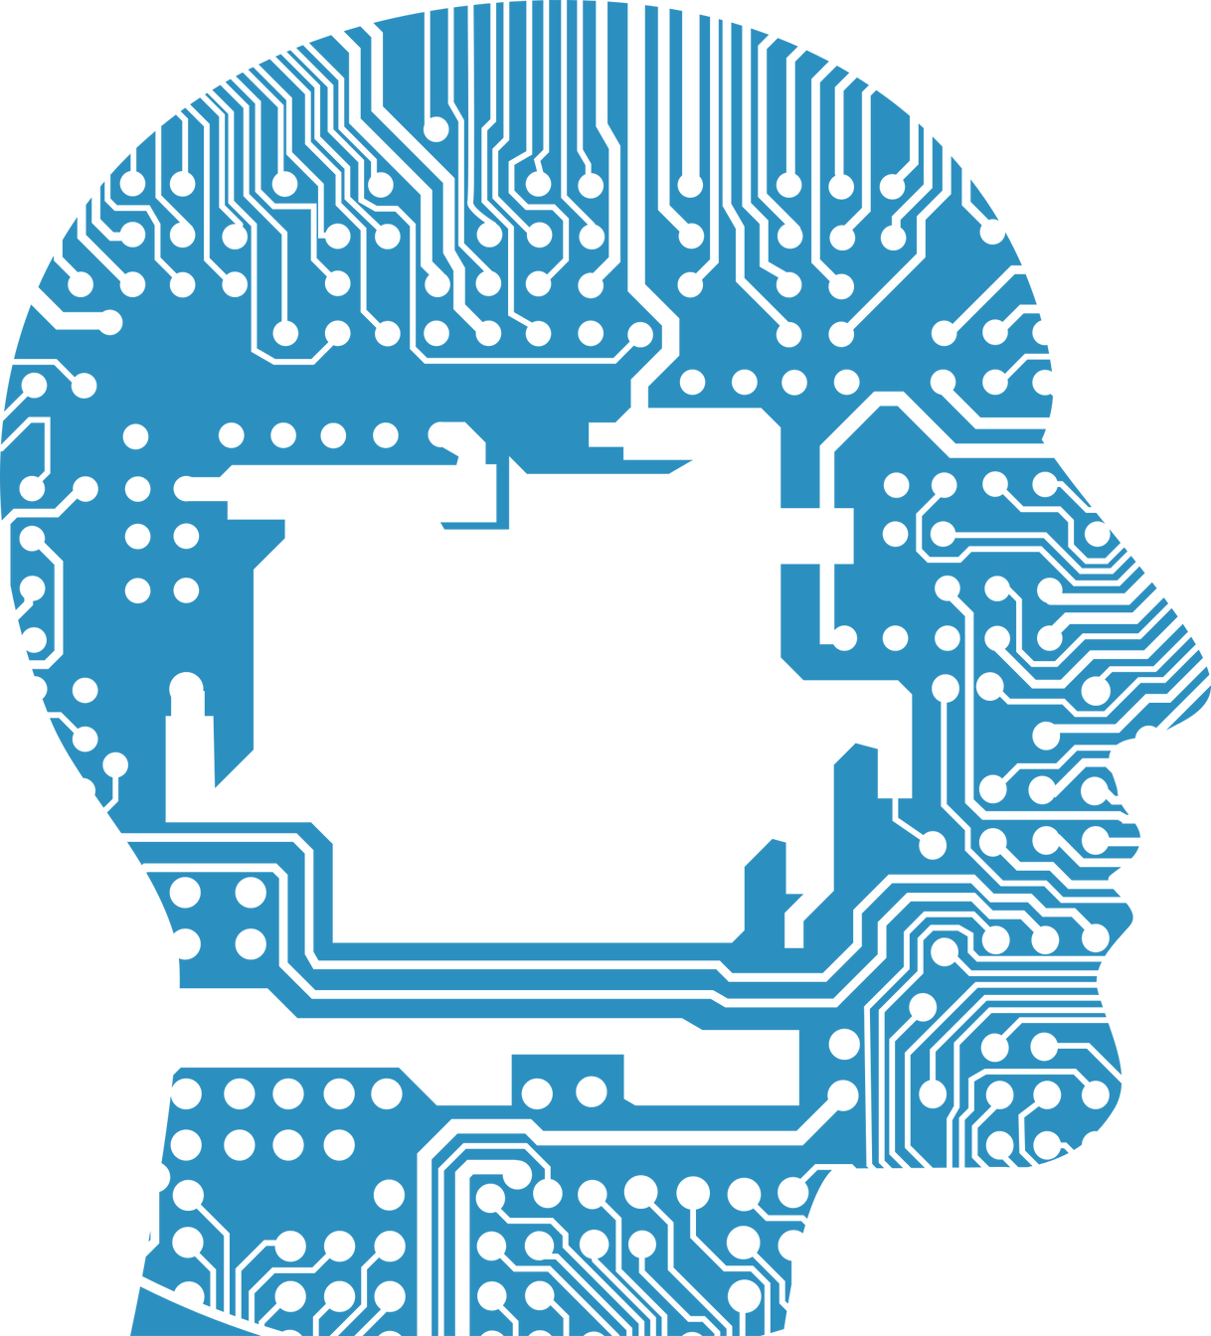
presentation agenda
Introduction
Workshop Theme
General information
The main topic covered in this workshop
Benefits
The main advantage of this workshop

Slide 3
Introduction
This workshop aimed to target youngest participated to expand their knowledge in blockchain.
Workshops offer detailed explanations and hands-on exercises that give you a comprehensive understanding of blockchain in python.

Slide 4
Workshop Theme
Session one Structure and syntax of Python | Session two What is Blockchain | Session three Blockchain Technology in python code
Part one: Fundamental Structures and concepts in Python Programming Set up the environment. Run first “ Hello World”. Conditional statements (if-elif-else). Loops (for loop and while loop). Functions in python. Classes and objects python. Importing modules python. Part two : build simple application Fibonacci sequence. Simple calculator. Generating random number. Checking number prime. | Understanding the basics of blockchain. Key components and characteristics Real-world use cases and industry applications | Blockchain configuration in Python Blockchain.py file Transactions class ( def: get_open_transactions. , def: load_data of the transaction and def: save_data) Proof of work class (def: proof_of_work , def: get_balance , def: get_last_blockchain_value ,def: add_transaction) Mining class (def: mine_block + wallet connection., def:add_block and def: resolve) Block mining class (def add_peer_node , def remove_peer_node and def get_peer_node) Block.py def: the genesis file node.py def the app with Flask, and CORS wallet.py def create_keys, def save_keys ,, def load_keys , def generate_keys ,def ,sign_transaction ,def verify_transaction UI configure the user interface with Html

Slide 5
Blockchain in python
Backend
Server port Flask
Frontend
Blockchain.py
Wallet.py
Node.py
UI
transactions.py
block.py

Slide 6
Benefits of Workshop
In-depth understanding Blockchain and python | Practical experience Involve practical coding exercises and projects | Guidance from experts Get engaged with experts in field
 | Boost career prospects Acquiring skills in blockchain

Slide 7
THANK YOU!

